Slide 1
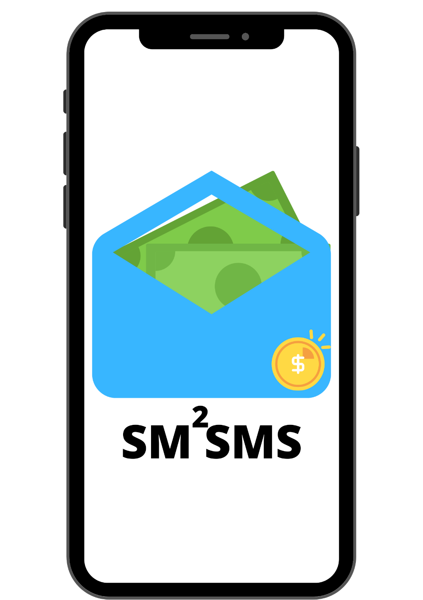

SM²SMS
A Wallet That can make payments, without the internet!

Slide 2
OBJECTIVE: Ever stuck with payments due to connectivity issues? Or run out of cash at remote places ?
It often happens that we struggle with our online payment apps due to internet connectivity issues, be it in areas with no internet coverage or even in those big metropolitans due to connectivity issues. Here is a product, an application that eradicates all our P2P payment issues, and that too while going internet free!
SM2SMS provides users with a wallet, that you can load money while you have internet connectivity, and not only that it also provides you the option to get some emergency credit offline as well, amount of which is decided upon the transactions and payments that you have done through the application.

Slide 3
SCOPE OF THE PROJECT:
Our primary aim is to eradicate the dependency on internet for digital payments and make payments easy for all. Apart from the internet free transaction approach, we wish to build upon an application that does normal payments just like any other payments app online as well.
While India still struggles with the proper internet connectivity along all the horizons the main issue that our application will address is to provide a medium wherein transactions are possible even with or without internet.
There are sections of the society that still do not have an internet connection, also people who avoid making online transactions and still believe as cash payments being the most secure medium of transactions, the application shall provide for users without the internet an access to digital payments.

Slide 4
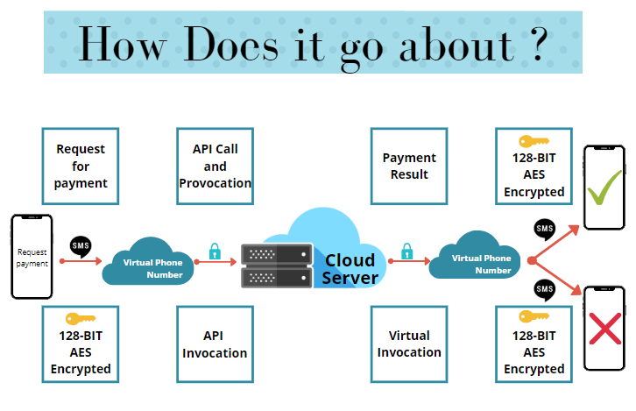

Slide 5
But How Does it Work ?
The following steps are followed once a payment request is made:
1. The application uses your sms messaging in the backend to send a payment request on our virtual number.
2. The message uses 128 BIT AES encryption and is sent completely in the background, which is deleted eventually after a few seconds from the users phone as well.
3. Our virtual number is used to trigger an API request to our backend server.
4. The backend server will verify the request, crosscheck with wallet balance, credit it to the receiver and then send an sms to our virtual number upon successful payment.
5. The virtual number shall send an sms to both the receiver on successful payment or otherwise.
6. The broadcast receiver shall decrypt the message and a payment complete status will appear on the application of both the peers, or otherwise.

Slide 6

Features:
1. Payments can be made without internet
2. Provides emergency credit.
3. ML based model to predict emergency credit limit.
4. Works with a single sim registered on our server.
5. 128-BIT AES encrypted data transport
6. Real-Time Pear-to-Pear Payments.
7. Secure PIN and Fingerprint Authentication.
8. User- Friendly UI
9. Easy to Use

Slide 7
Thank You!

